Slide 1
Machine Learning with Raspberry Pi
Lesson 2: DC Motor
AI Code Academy

Slide 2
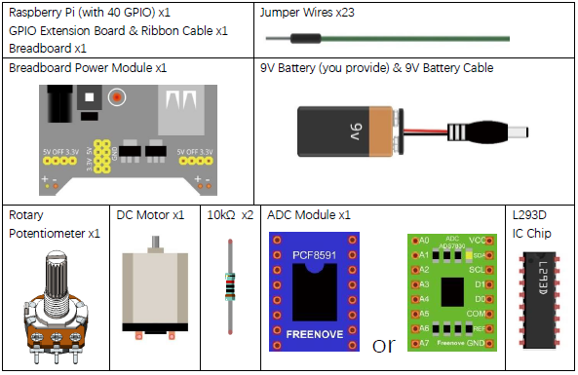
Materials Needed
For this lesson, we’ll need the following materials:
Raspberry Pi with SSH and VNC connection
Breadboard
GPIO extension board and wire
220 Ohm resistor
Button
ADC Module
Potentiometer
Power Module
DC Motor
Motor Driver
Jumper wires

Slide 3
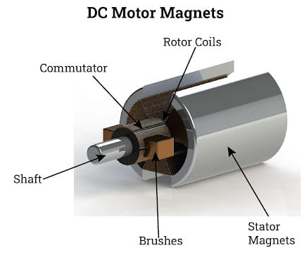
DC Motors
In the past we have worked with motors and are extremely useful in a wide array of projects with most robotics projects requiring many different motors.
DC motors convert electrical energy into mechanical energy and will consist of two primary components: stator and rotor.
Stator: the outer casing including magnets and power terminals to connect the electromagnetic coils. Most hobby DC motors use a pair of permanent magnets.
Rotor: the part of the motor that rotates, comprised of the shaft and several electromagnets connected to a commutator to supply electrical power.

Slide 4
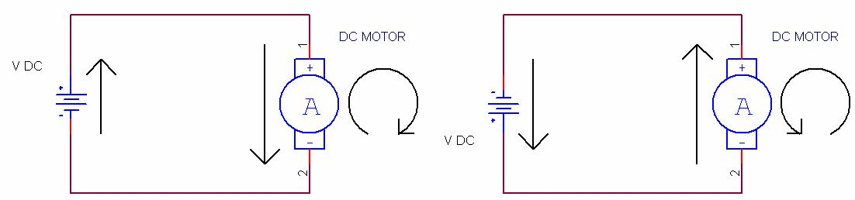
Motors
To power on the DC motor, connect one pin of the motor to 3.3V and the other to GND. If you place the 3.3V on the other pin, the motor will rotate in the other direction.
To rotate at various speeds, we must vary the voltage that we apply to the motor.
How can we do this?

Slide 5
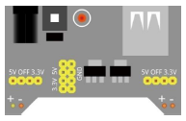
Power Module
We can turn on the motor with the 3.3V and 5V, but if we try to use PWM and a GPIO pin to control the motor, we will have trouble controlling the speed.
The Pi is unable to supply enough power to the motor using the GPIO pins so we will need to supply power with a different power source.
To resolve this issue, we will use an additional power module and use a 9V battery to provide power.
Please select the jumpers to set 3.3V on off for the right side of the module and 5V and off for the left.

Slide 6

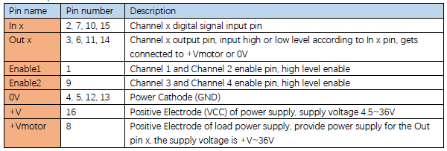
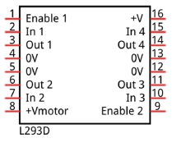
Motor Driver
The L293D motor driver IC will allow us to control the speed of our motor with a digital input and switch the direction at which it spins.
The driver supports a unidirectional DC motor with 4 ports and a bi-directional motor with 2 ports.

Slide 7
Motor Driver
The In 1 and In 2 pins will allow us to control the direction and speed the motor spins.
The Enable 1 pin will enable the motor’s output.
The Out 1 and Out 2 pins will be connected the motor to output power to it.

Slide 8
Project
For our project, we are going to create a circuit and a program that will rotate the motor in one direction when a potentiometer is turned to the right and the opposite direction if turned to the left.
We will use the ADC values from 0-127 for turning backwards and we will use 129-255 for turning forward. 128 will be used for stopping the motor.
For simplicity, we will alter this number so that we use a negative number to indicate the direction.

Slide 9
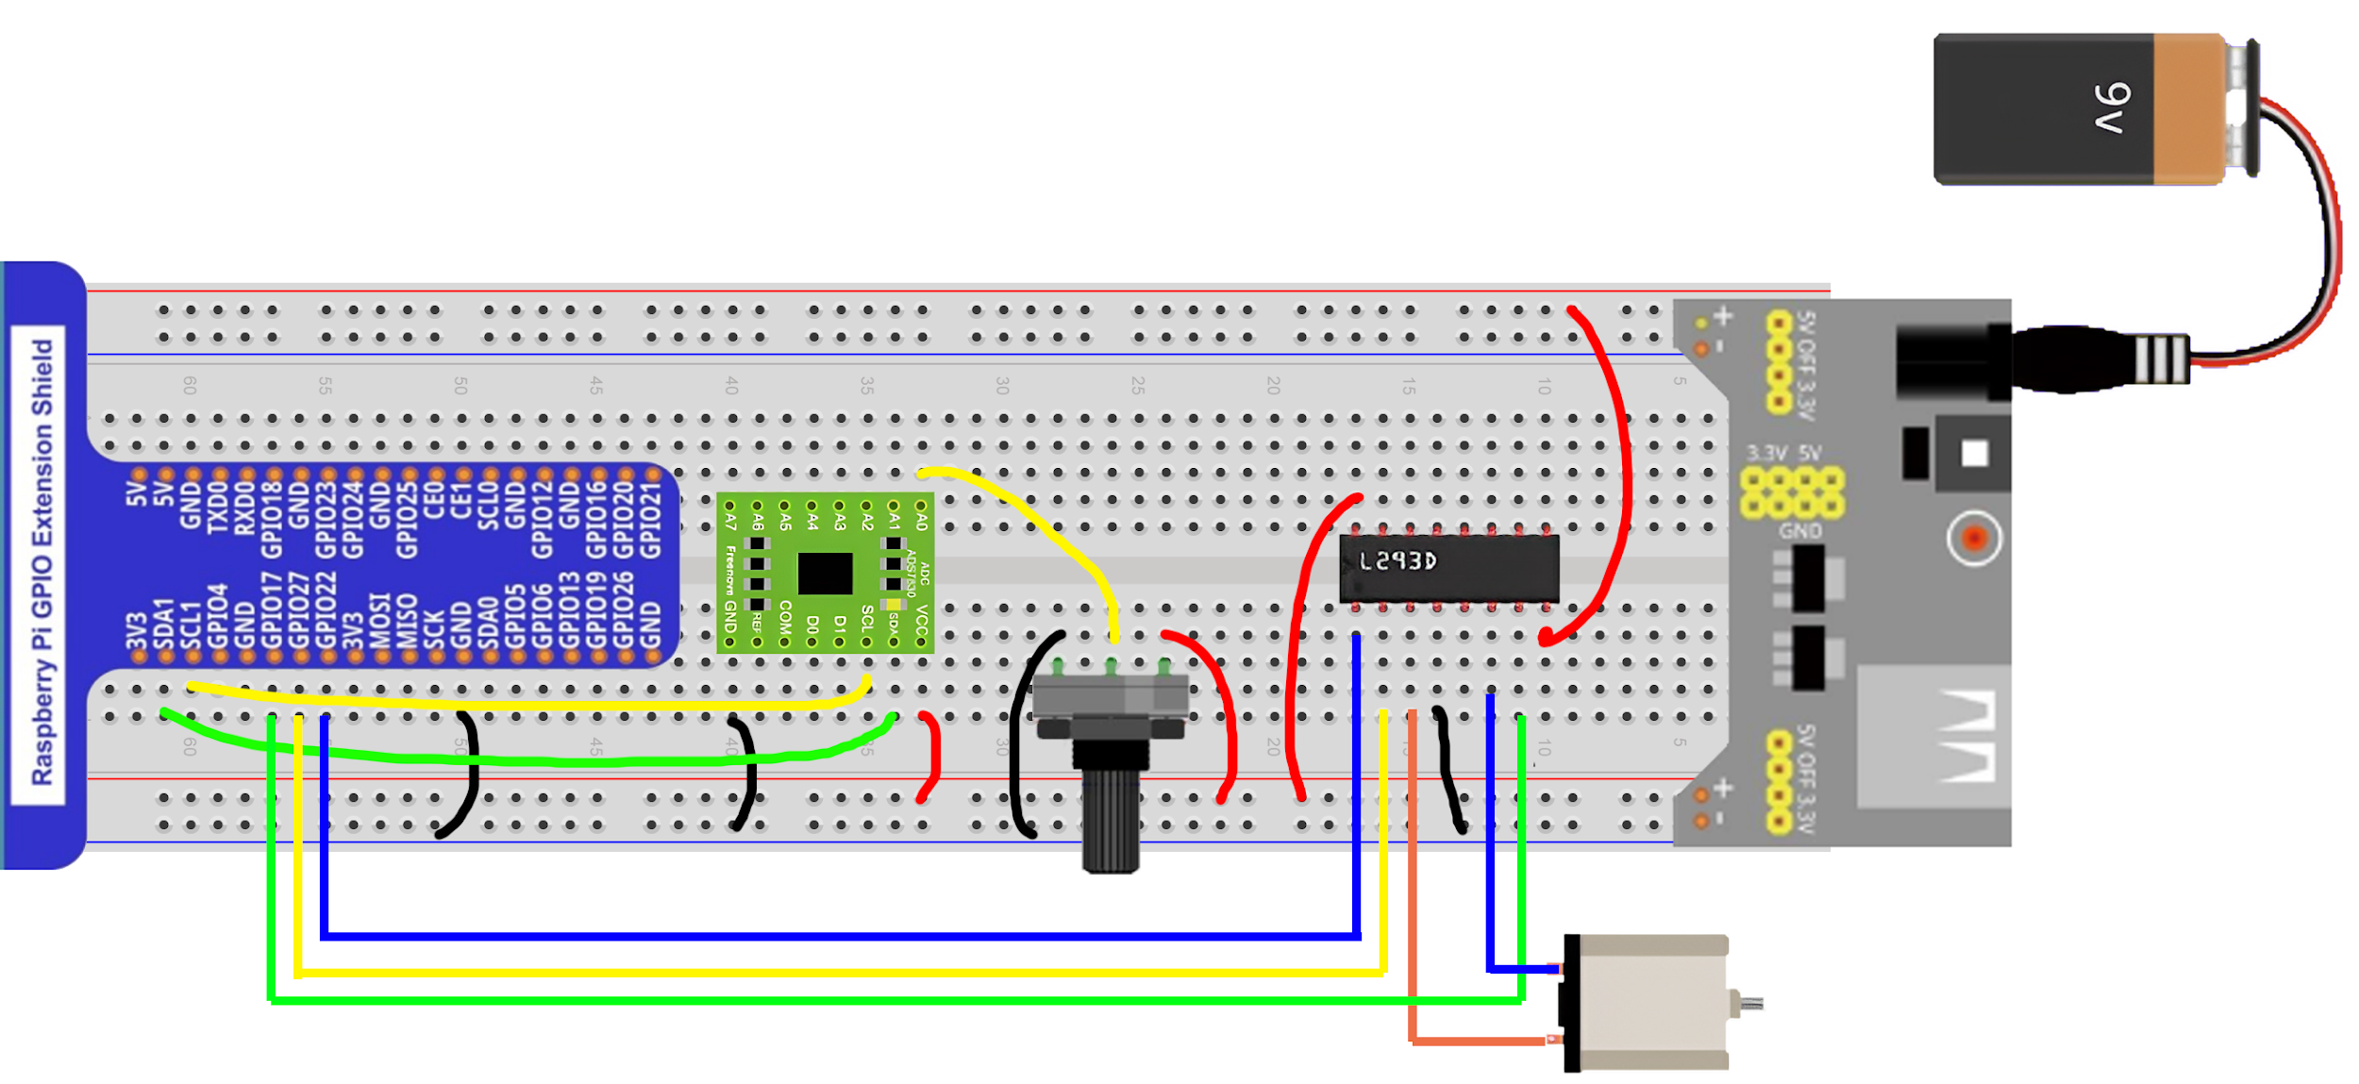
Circuit for this Project

Slide 10
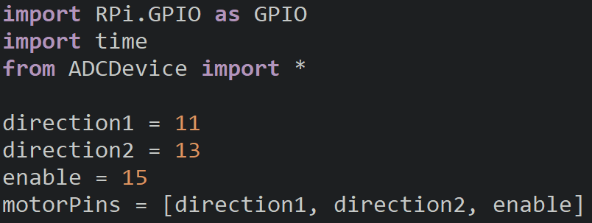
Bi-Directional Motor Control
Import modules and create variables to store the pin numbers for our motor driver input (direction1 and direction2) and the enable pin.
We will then store them in a list and create our ADC device.

Slide 11
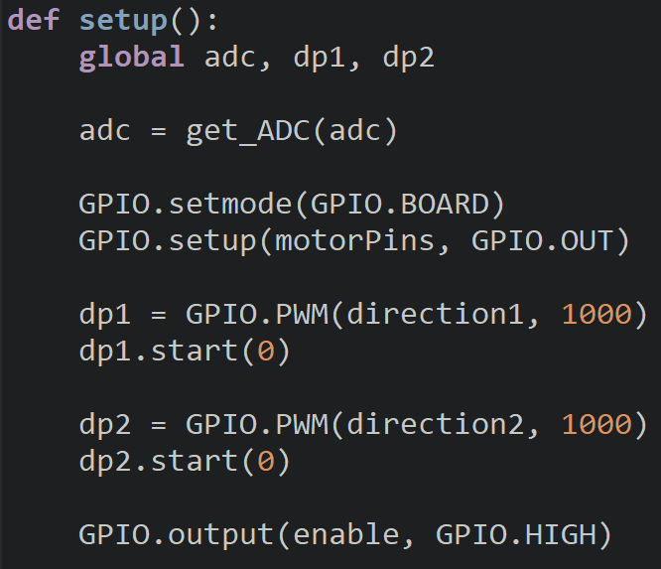
Motor Setup
Inside the setup function, we will first setup the ADC module and then configure our motor pins to be outputs.
Create and start a PWM pin for each direction, dp1 and dp2.
Set the enable pin to high to enable the motor output.

Slide 12
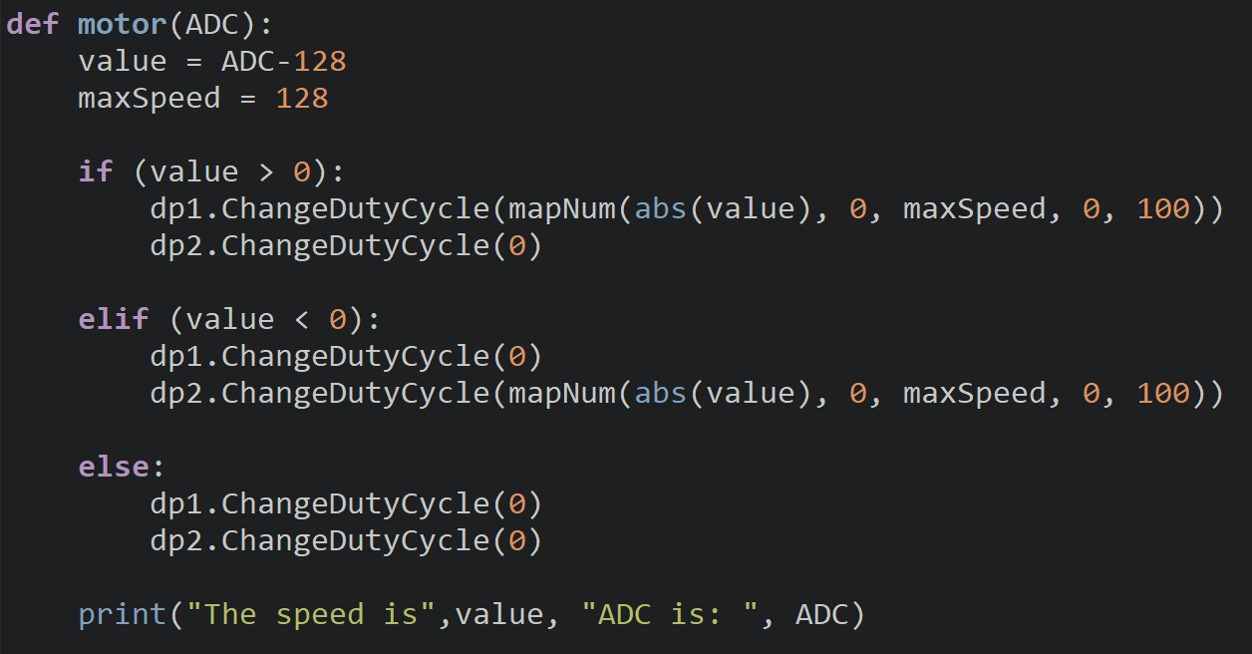
Motor Control
We then will create a motor function that will take an ADC value as input. The value we output to the motor will be stored in a value variable alongside our max speed.
We then will have an if-elif-else branch to determine which pin will be set to GND and which will output the duty cycle.
mapNum converts the speed into a duty cycle percentage. The use the absolute value of our speed since the negative sign only shows direction.
Notes:
The mapNum function was shown in the pi level 1 class for the servo motor lesson. It is just the equation of a line in slope intercept form.

Slide 13
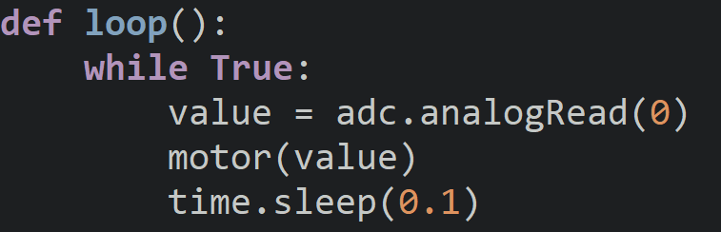
Motor Loop
Inside of our main loop we will read the value of the potentiometer and then call the motor function.
After that we will then sleep for 0.1 secs before updating the motor.

Slide 14
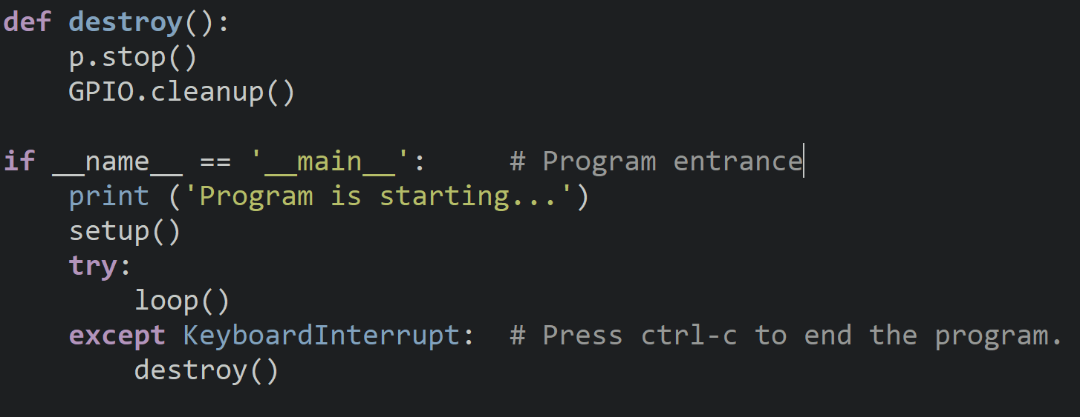
DC_Motor.py
To finish off this program, we have the destroy and entry code.

Slide 15
Try It Out
Are you able to control the speed of the motor and make it switch directions and move faster?
Are there any additional features we would want to add?

Slide 16
Emergency Stop
Often with devices that move it is best to have a way to stop it from moving in case of an emergency.
If you wanted to use this project away from your keyboard, you would need to adjust the speed before the motor would stop.
In situations like these, it is best to have a button or a switch to stop everything quickly.
We will add a button to our circuit and will use GPIO 26 for the input. Make a copy of your code and we will make these adjustments.

Slide 17
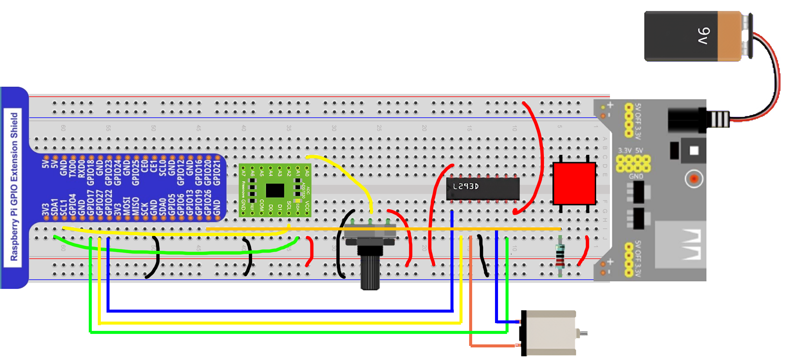
Modified Circuit

Slide 18
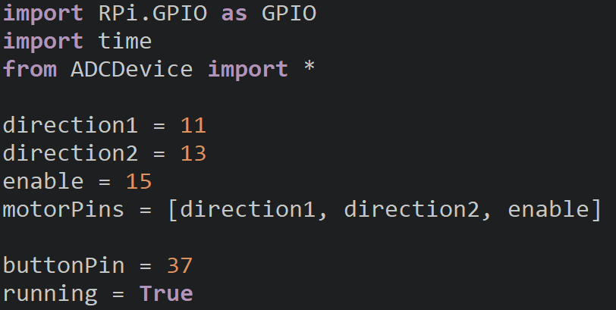
Setup
Add two new variables to the start of the code, one will be for the button pin number and the other is a Boolean to represent if we are running the motor.
By default, we will enable the motor, we could modify this, so it is disabled by default.

Slide 19
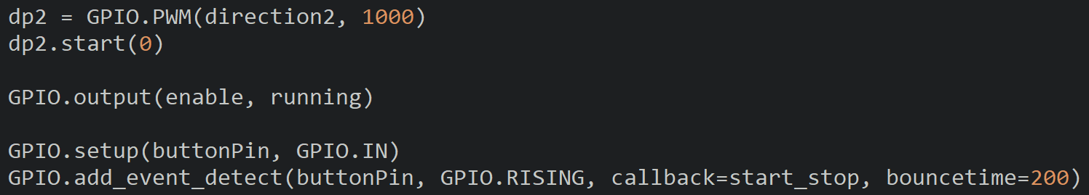
Setup
In the setup function, configure the button to be an input and add an interrupt for the button to call the start_stop function. Also change the enable pin to output the value of running.

Slide 20
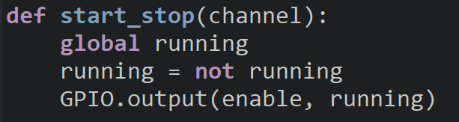
Interrupt
The start_stop function will invert the value of the running variable and then output the Boolean to the enable pin.
Using Booleans will make it easier for use to just invert the value of the variable running and output it directly to the enable pin.

Slide 21
Discussion
Did the motor stop when you pressed the button?
What are some applications for the DC motor that you have used in your life?
What other features could we add to our project?
Any ideas for how we could measure the speed of our motor so that we can have a more precise speed?

Slide 22
Power off
As usual, shut down your pi properly before disconnecting power.

